Slide 1
Conceptual modeling
Read chapter 12, Connolly and begg

Slide 2
overview
Conceptual Modeling
Transforms requirements specs into technical representation
Frees from possible distortions of
Language/grammar
View points
Interpretation / lack of it
Standard for the same data model
Independent of the DBMS chosen

Slide 3
Overview….
What is involved
Interpreted the requirements
Identify the Entities
Identify the Attributes
Identify the relationships
Identify the constraints
Represent them on a single model
Which is independent of the language in which the specs were written
Also independent of the grammatical choices

Slide 4
Entities
Class/grouping of items that make up the application/system
For example ; Student, staff, course, country, etc
Entities need not to be physical/tangible
But must logically exist in the application being modeled
Entities are either strong or weak
Strong entities have occurrences that exist in their own right
Weak entities have occurrences that need another entity occurrence to exist
In a university system, a student is a strong entity, a parent is a weak entity (WHY?)
When writing entities
Start with capital letter
If multiple words, each word starts with Capital
No space
Student

Slide 5
Attributes
Characteristics of entities with which we identify their occurencies
Entity student: Attributes – name, dateOfBirth, gender, tribe, …..
It is the difference in instances of attributes that separate the occurancies
Attribute types
Simple: they are atomic
Composite: attributes made up of components eg name – firstName, surName
Multi valued: attributes with multiple values for the same occurances, eg qualification
Derived: attributes that are derived from other attribute. Eg age derived from dateOfBirth
We normally don’t store a derived attribute
When writing attribute, start with small letter. Multiple word attributes start subsequent words with the capital letter

Slide 6
Relationships
Shows a conceptual linkage between entities eg Student offersA Program
Relationships are
Binary – between two entities
Cyclic – on one entity
Complex/Ternary/N-Ray – among more than two entities
Some relationships have attributes
Eg Student registerdFor Course << score>>
Rlshp

Slide 7
Relationships
Multiplicities
Relationships are understood deeply by the multiplicities they exhibit
Lower end s of multiplicities help understand “mandatory” or “ optional “ participation of entity occurrences
Upper end help in understanding the nature of relationship
One to one
One to many
Many to many
Useful at logical modeling

Slide 8
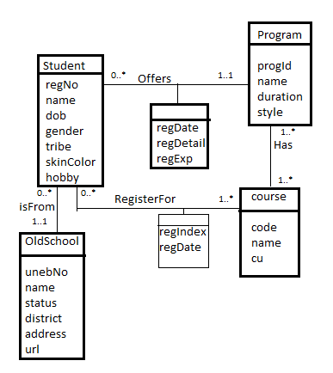
University student case
Take note of
Decisions on multiplicities
Derivation of nature of relationships
Optional and mandatory participation in relationship
Attributes of some relationships
And how they are presented

Slide 9
Conceptual traps
There are two main traps
The fan trap
The chasm trap
Have to be resolved at conceptual level, Otherwise
the data can be in the system but irretrievable
Some functional requirements will be impossible to implement

Slide 10
Fan trap
A combination of many – to – one – to - many relationships where a transitive relationship is necessary for the remote entities
Example
Student EnrolledIn University
University Has Program
Can we tell which program the student is enrolled in??
Way out is
Create a relationship between the remote entities
Eliminate a redundant relationship – if any

Slide 11
Chasm trap
Chasm trap occur when a model suggests relationship between entity types however a path between certain occurrences does not exist.
Conceptual model suggests a relationship between two entities
But the path between some occurrences do not exist due to double optional participation
Eg
Branch has staff, staff oversees property
Can be addressed by
Creating a direct relationship between the entities of interest
Eliminating redundant relationship if need be

